Slide 1
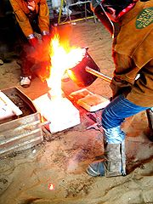
Advance Casting Process
IC141
Even Semester February-June 2014
Lecture #10
Dr. Mohammad Talha
Asst. Professor
School of Engineering
Indian Institute of Technology Mandi
H.P., INDIA, 175 001
talha@iitmandi.ac.in

Slide 2
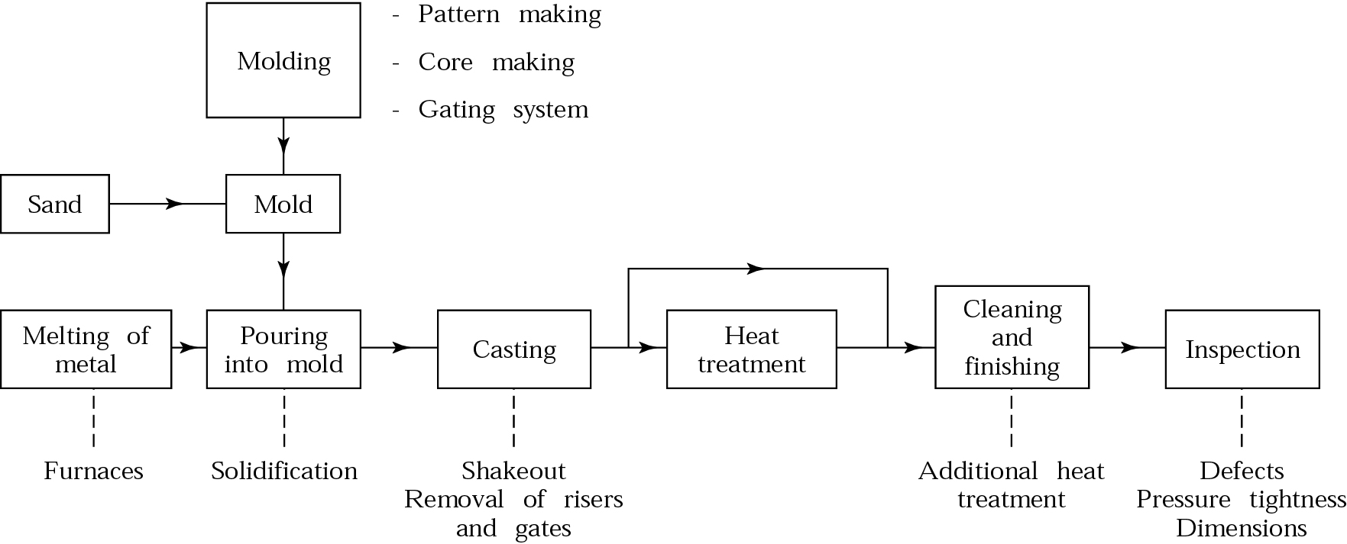
SAND CASTING

Slide 3
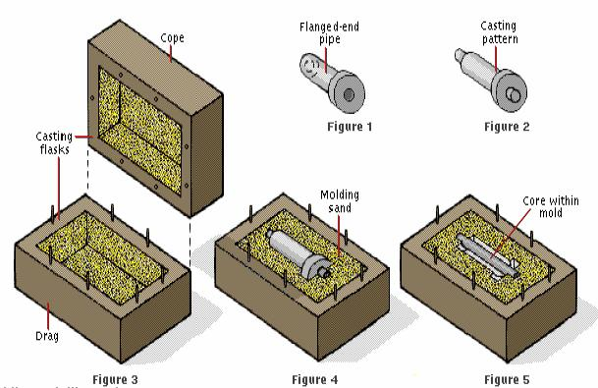
SAND CASTING
The set of channels through which a molten metal flows to the mold cavity is called gating system.

Slide 4
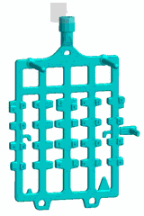
Lost foam casting
Lost foam casting uses foam patterns as a mold.
The method takes advantage of the properties of foam to simply and inexpensively create castings that would be difficult to achieve using other casting techniques.

Slide 5
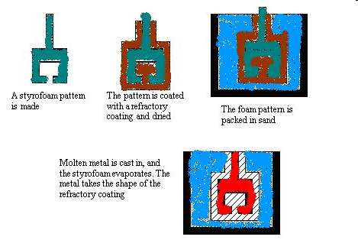
LOST FOAM CASTING

Slide 6
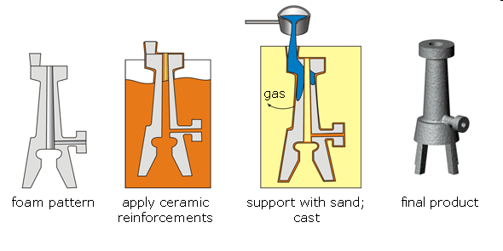
LOST FOAM CASTING

Slide 7
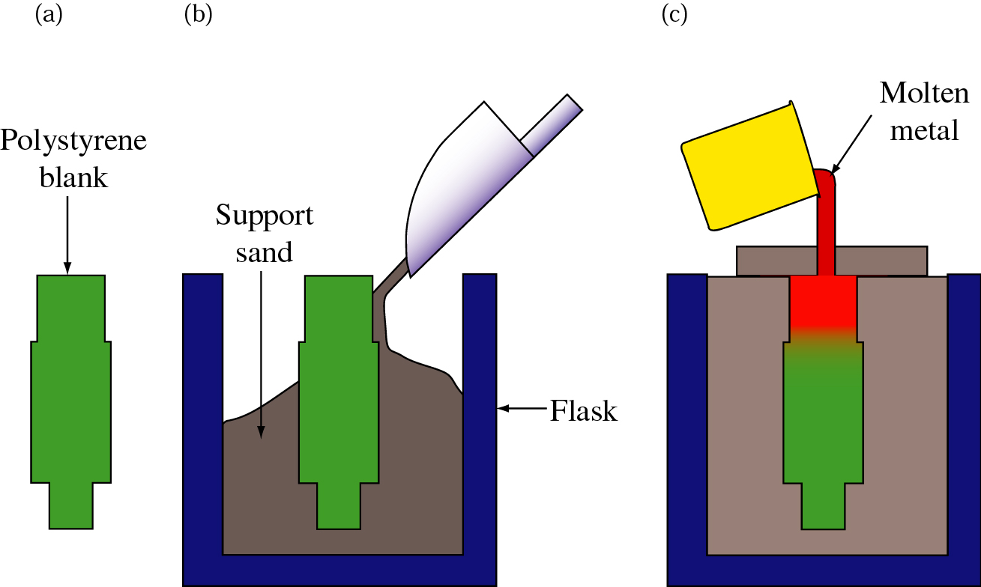
Expendable Pattern Casting
Illustration of the expendable pattern casting process, also known as lost foam or evaporative casting.

Slide 8
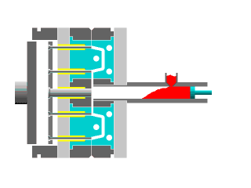
DIE CASTING
Liquid metal injected into reusable steel mold, or die, very quickly with high pressures .
Die casting is a process in which the molten metal is injected into the mold cavity at an increased pressure
The mold used in the die casting process is called a die.

Slide 9
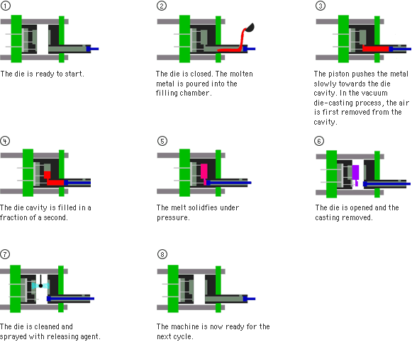

Slide 10
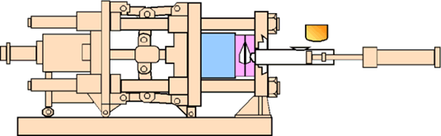
DIE CASTING
COLD CHAMBER
In a cold chamber process, the molten metal is ladled into the cold chamber for each shot.
There is less time exposure of the melt to the plunger walls or the plunger.
This is particularly useful for metals such as Aluminum, and Copper (and its alloys) that alloy easily with Iron at the higher temperatures.

Slide 11
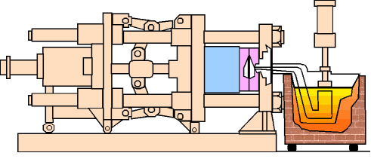
DIE CASTING
HOT CHAMBER
In a hot chamber process the pressure chamber is connected to the die cavity is immersed permanently in the molten metal.
The hot chamber process is used for metals of low melting point and high fluidity such as tin, zinc, and lead that tend not to alloy easily with steel at their melt temperatures.

Slide 12
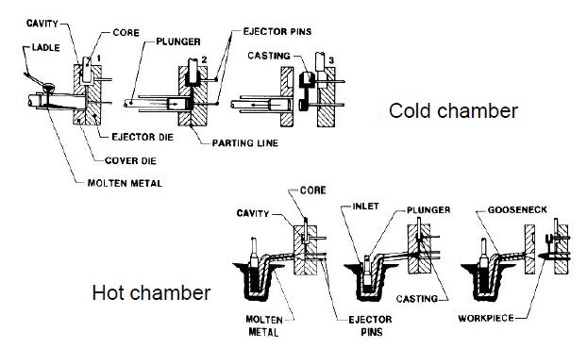

Slide 13
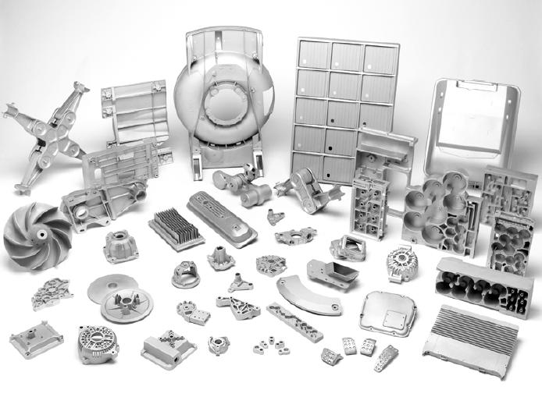

Slide 14
Ceramic Mold Casting
Mold is made from ceramic material
Ceramics can withstand higher temperatures
Greater cost and not reusable for mold
Shaw process
  Reusable pattern inside a slightly tapered flask
  Mixture sets to a rubbery state that allows the part and flask to be removed
  Mold surface is then ignited with a torch

Slide 15
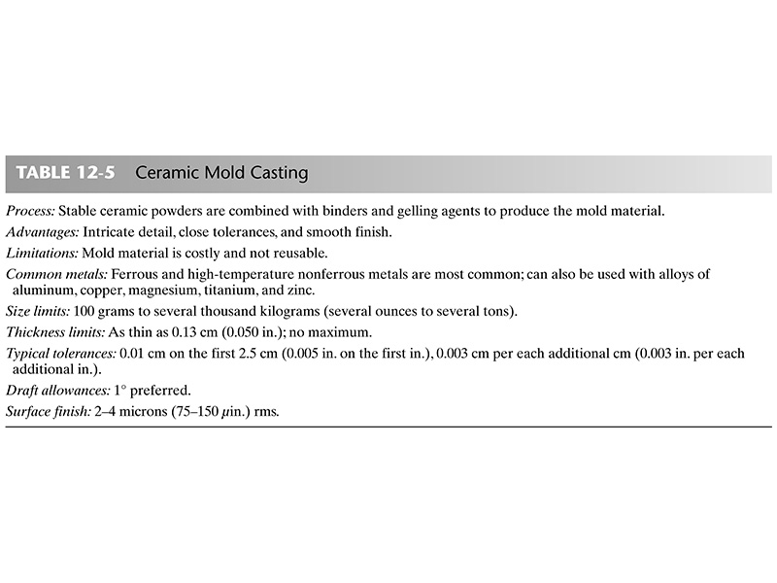

Slide 16
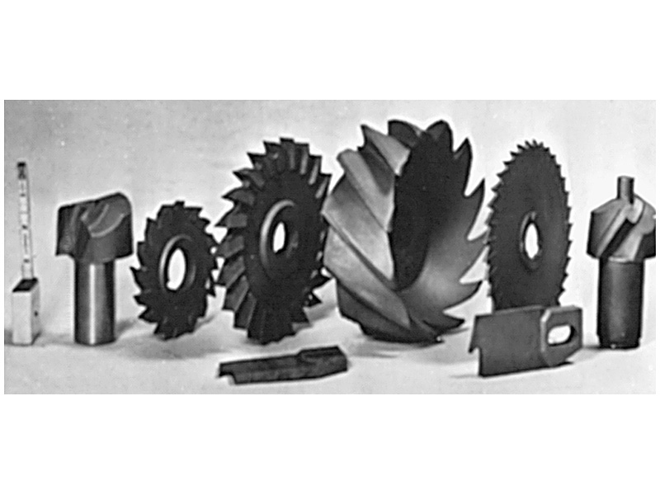
Group of intricate cutters produced by ceramic mold casting.
(Courtesy of Avnet Shaw Division of Avnet, Inc., Phoenix, AZ)

Slide 17
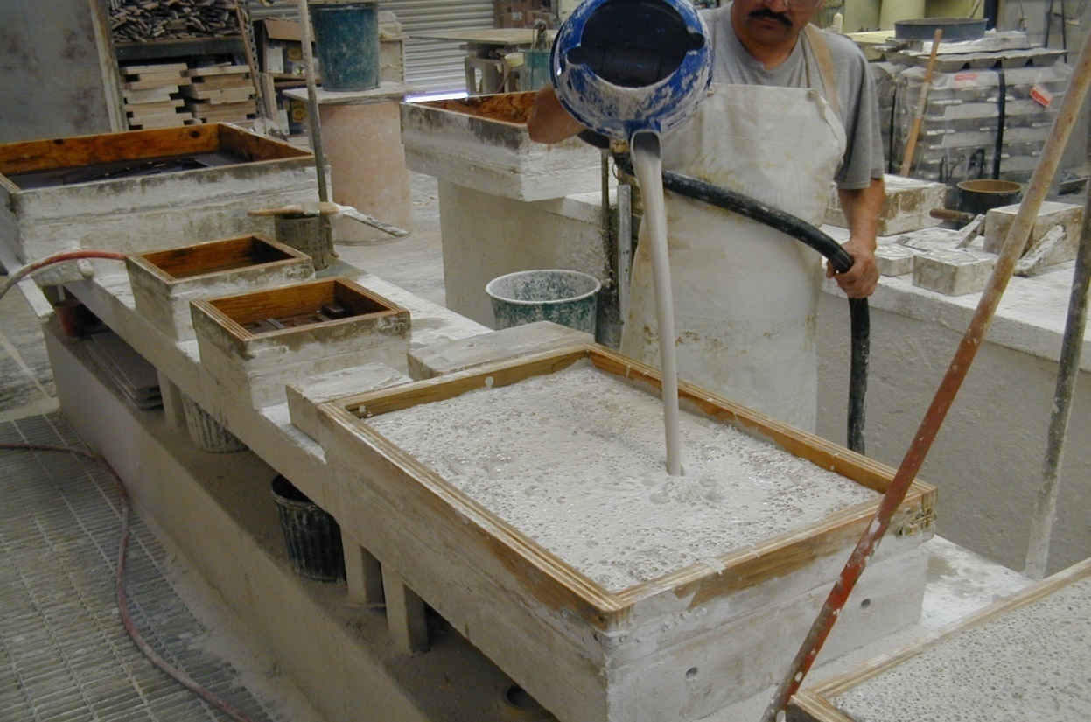
Plaster Molding Process
Mold is made from a mixture of plaster, talc, other refractory materials and water
Slurry is poured or piped into a flask containing the pattern
Mold is dried in a circulating air oven until no moisture is present

Slide 18
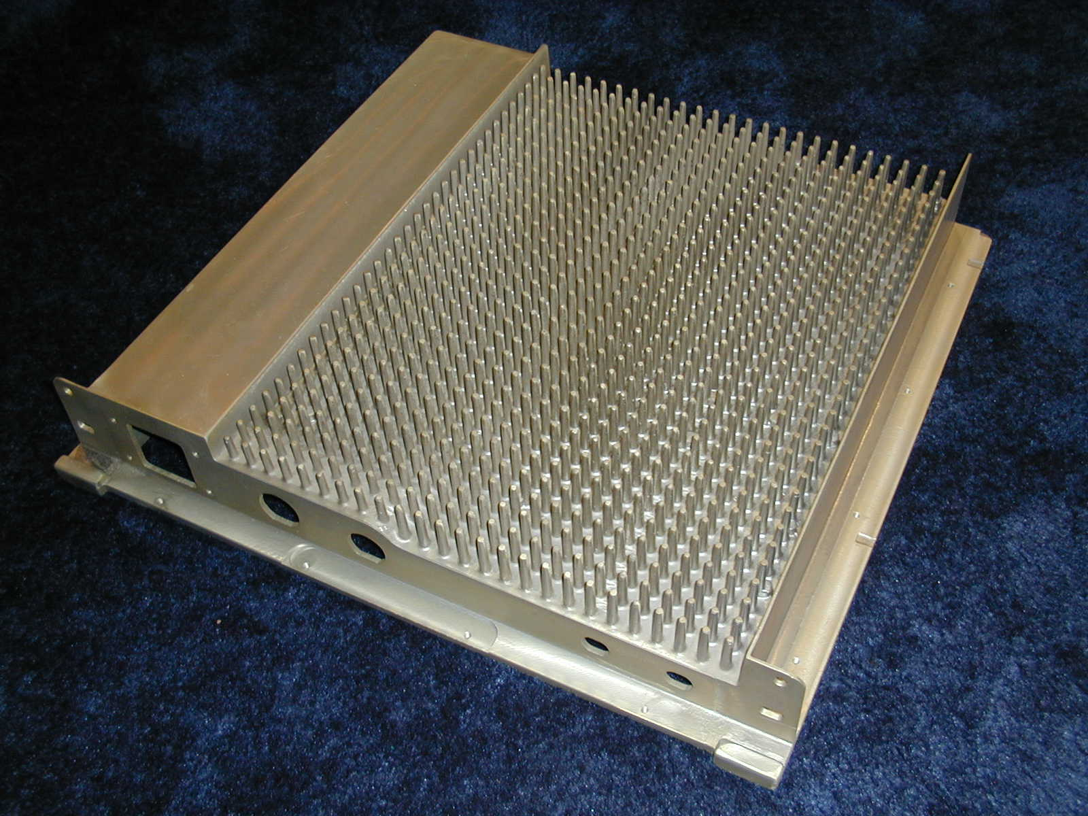
Rubber Plaster Mold process
Commonly replaces plastic injection molding with aluminum casting
Natural EMI RF Shielding
Tolerances: +/- 0.010” first 8 inches.
20 days from CAD files to delivery (inc. machining)

Slide 19
Plaster Advantages
High casting yield
  no gas or steam produced when metal is poured
Fine detail & intricate thin sections possible
Very little cleaning, if any, needed
Plaster Drawbacks
Drying time can take hours and can cause warpage or shrinkage of the mold
Low to medium volume production capabilities
Limited alloys - usually nonferrous

Slide 20
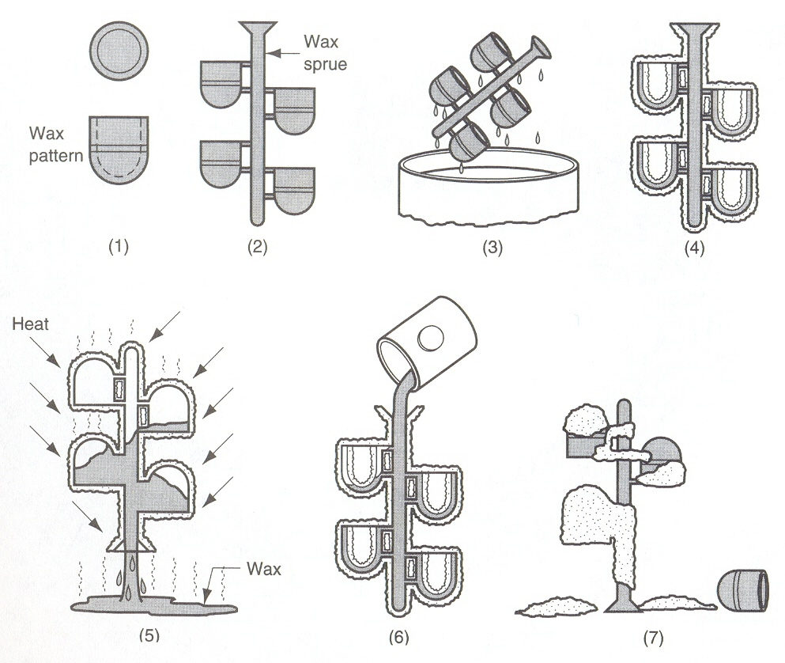
Casting with expendable mould:
Investment Casting
Ceramic Shell Process

Slide 21
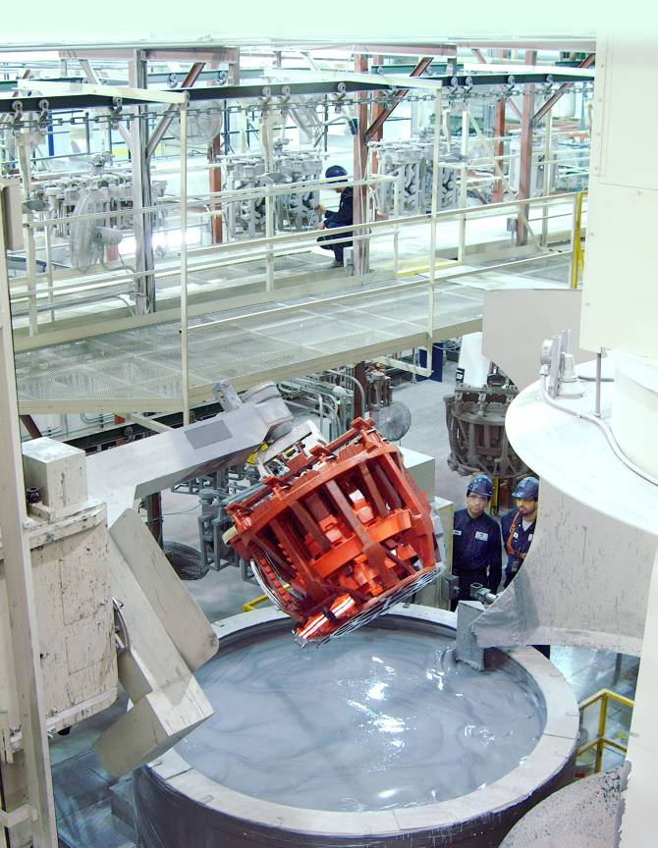
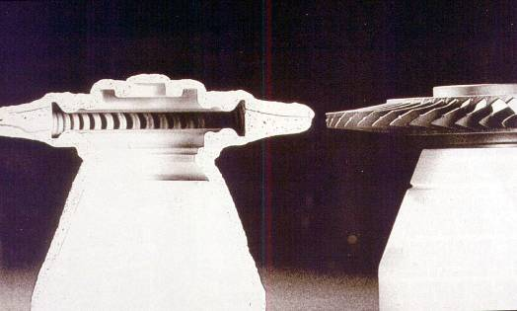

Slide 22

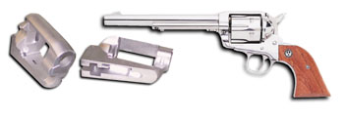
Investment Casting Advantages
Extremely accurate & flexible design parameters
Useful for casting difficult to machine alloys
Superior casting finish
Suitable for large or small quantities
Wide range of alloys cast
Cast in Stainless or Chrome-Moly Steel for Integrity, Cast-In Features and Aesthetics; All Ruger Castings Are Visible

Slide 23
Investment Casting Drawbacks
Casting size is limited
Costly process
  Equipment
  Patterns
  Process components very important
  Additional quality checks required

Slide 24
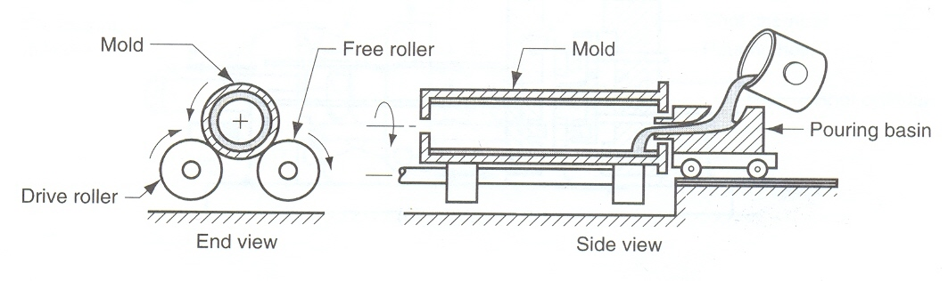
Centrifugal Casting
A permanent mold made of metal or ceramic is rotated at high speed (300 to 3000 rpm). The molten metal is then poured into the mold cavity and due to centrifugal action the molten metal conform to the cavity provided in the mould.
Applications: pipes, bushings, gears, flywheels etc.

Slide 25
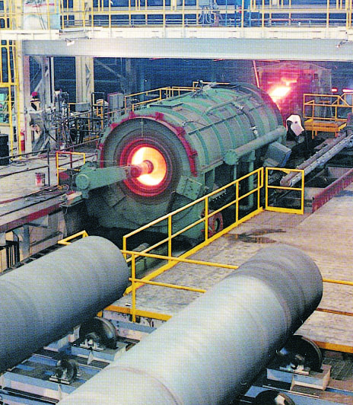
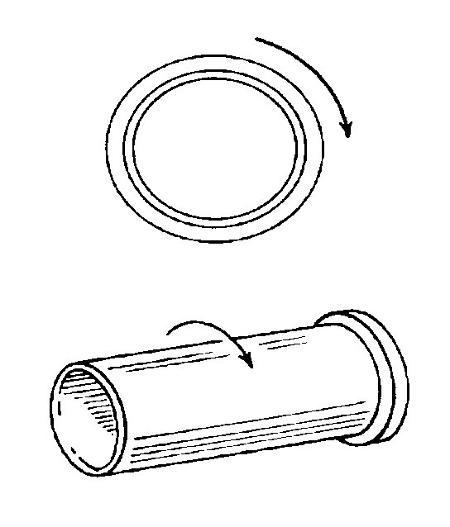
Centrifugal Casting
Casting is spun on its own axis
No risers are required
No center core is needed

Slide 26
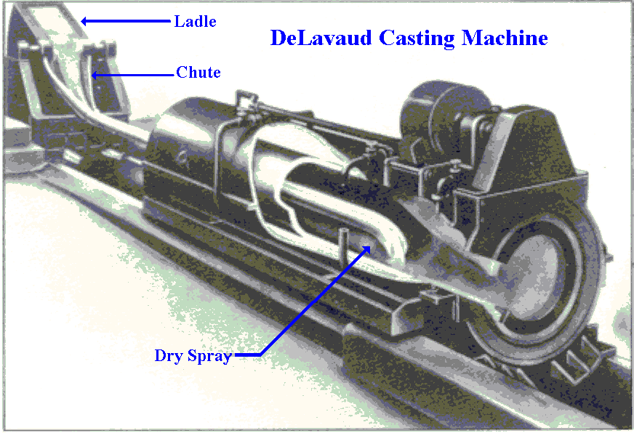
Centrifugal Casting Machine
Developed ~1923

Slide 27
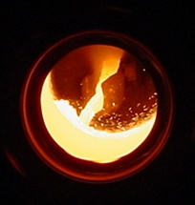
Pipe Casting Machine
Iron Flowing into the Mold at ~2340°F.
Plant produces about
4 miles of pipe/day.
Pipe are approximately 85-90% recycled materials.

Slide 28
Centrifugal Casting Advantages
Improved homogeneity
Improved accuracy in special circumstances
Centrifugal Casting Drawback
Limitations on casting shape

Slide 29
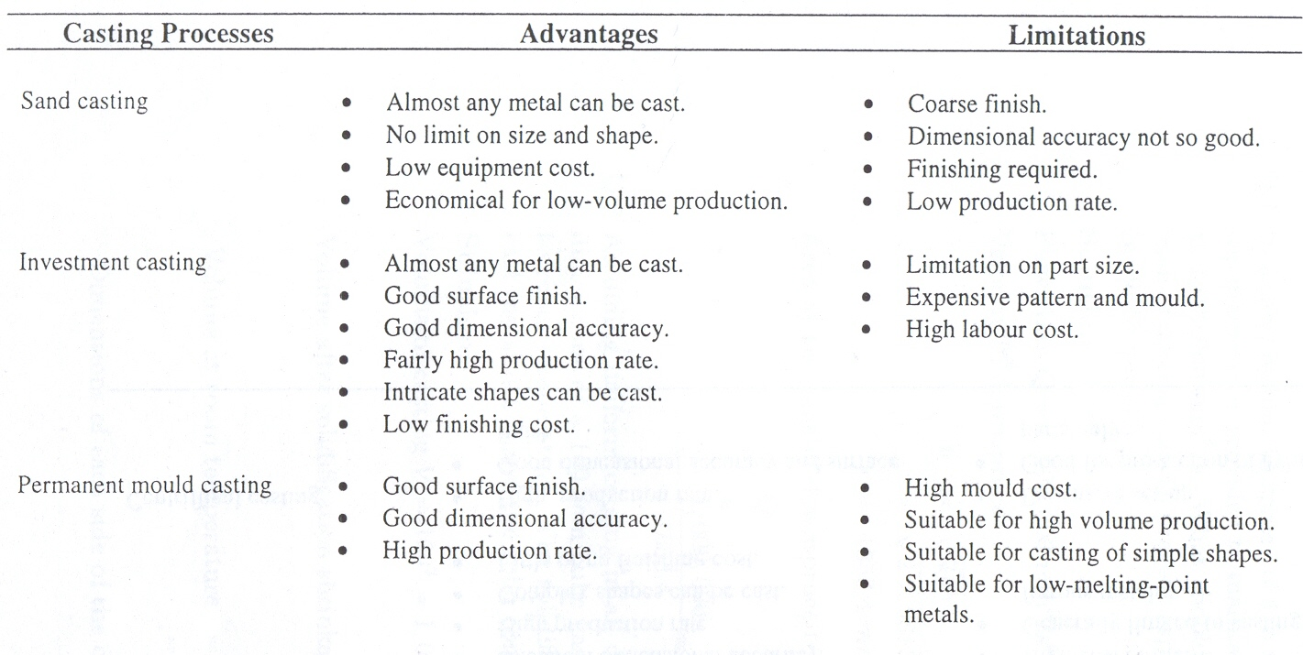
Comparison of Casting Processes

Slide 30
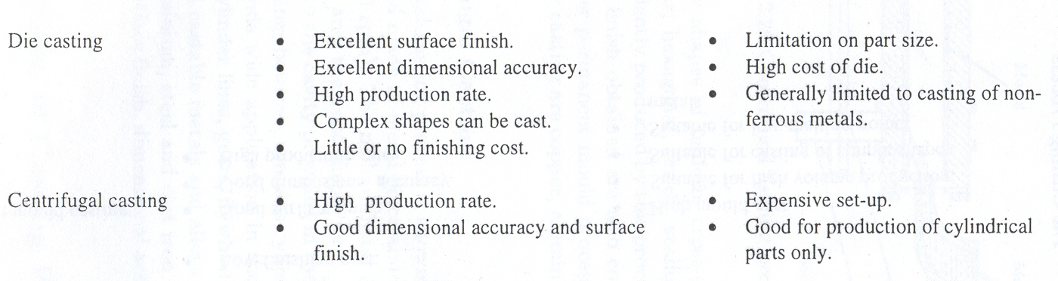

Slide 32
Lecture presented herein are taken from different sources
like Internet, books, etc.
End of lecture #10

